Slide 1
CMP301 – Computer Networking Lecture Week 10
Network Security
Dr. Omar Nibouche

Slide 2
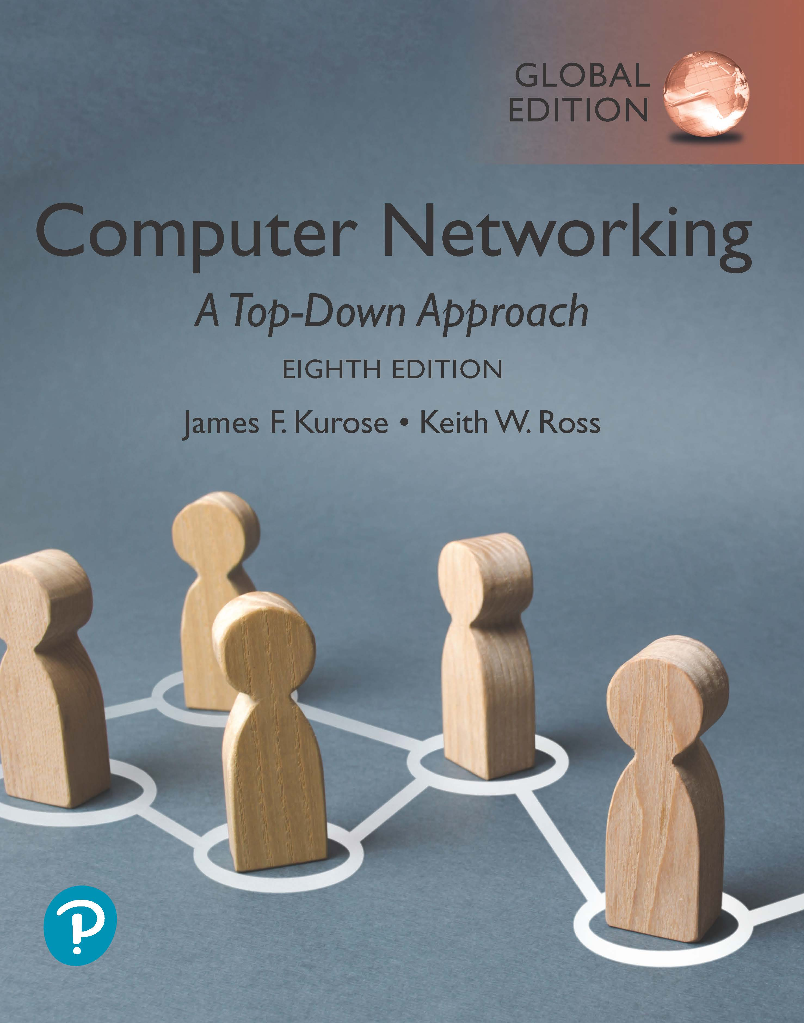
Security: overview
security in practice:
firewalls and intrusion detection systems
security in transport layers
Securing TCP connections: TLS
Operational security: firewalls and IDS
Computer Networking: A Top-Down Approach 8th edition, Global Edition Jim Kurose, Keith Ross Copyright © 2022 Pearson Education Ltd

Slide 3

Public key Certification Authorities (CA)
certification authority (CA): binds public key to particular entity, E
entity (person, website, router) registers its public key with CE provides “proof of identity” to CA
CA creates certificate binding identity E to E’s public key
certificate containing E’s public key digitally signed by CA: CA says “this is E’s public key”
Bob’s
public
key
digital
signature
(encrypt)
+
+
K
K
B
B
CA’s
private
key
-
certificate for Bob’s public key, signed by CA
Bob’s
identifying information
K
CA

Slide 4
Public key Certification Authorities (CA)
when Alice wants Bob’s public key:
gets Bob’s certificate (Bob or elsewhere)
apply CA’s public key to Bob’s certificate, get Bob’s public key
+
digital
signature
(decrypt)
Bob’s
public
key
K
+
B
K
B
CA’s
public
key
+
K
CA

Slide 5

Secure e-mail: confidentiality
Alice wants to send confidential e-mail, m, to Bob.
K_{S}
.
K_{S}(m )
K_{S}(m )
.
m
K_{S}( )
K_{S}( )
m
+
-
Internet
K_{S}
.
-
.
+
K_{S}
K_{B}( )
+
+
K_{B}( )
K_{B}(K_{S} )
K_{B}(K_{S} )
+
-
K_{B}
K_{B}
Alice:
generates random symmetric private key, K_{S}
encrypts message with K_{S} (for efficiency)
also encrypts K_{S} with Bob’s public key
sends both K_{S}(m) and K⁺_{B}(K_{S}) to Bob

Slide 6
Secure e-mail: confidentiality (more)
Alice wants to send confidential e-mail, m, to Bob.
K_{S}
.
K_{S}(m )
K_{S}(m )
.
m
K_{S}( )
K_{S}( )
m
+
-
Internet
K_{S}
.
-
.
+
K_{S}
K_{B}( )
+
+
K_{B}( )
K_{B}(K_{S} )
K_{B}(K_{S} )
+
-
K_{B}
K_{B}
Bob:
uses his private key to decrypt and recover K_{S}
uses K_{S} to decrypt K_{S}(m) to recover m

Slide 7
Secure e-mail: integrity, authentication
Alice wants to send m to Bob, with message integrity, authentication
-
+
K_{A}
K_{A}
.
.
-
-
.
-
K_{A}(H(m))
K_{A}(H(m))
+
H(m )
m
H( )
K_{A}( )
K_{A}( )
+
-
compare
Internet
.
m
H( )
H(m )
m
Alice digitally signs hash of her message with her private key, providing integrity and authentication
sends both message (in the clear) and digital signature

Slide 8
Secure e-mail: integrity, authentication
Alice sends m to Bob, with confidentiality, message integrity, authentication
-
K_{A}
-
confidentiality
.
.
K_{A}(H(m))
m
-
K_{S}
H( )
K_{A}( )
.
K_{S}(m )
+
K_{S}( )
m
+
Internet
message integrity, authentication
.
K_{S}
+
K_{B}( )
+
K_{B}(K_{S} )
+
K_{B}
Alice uses three keys: her private key, Bob’s public key, new symmetric key
What are Bob’s complementary actions?

Slide 9
Transport-layer security (TLS)
widely deployed security protocol above the transport layer
supported by almost all browsers, web servers: https (port 443)
provides:
confidentiality: via symmetric encryption
integrity: via cryptographic hashing
authentication: via public key cryptography
all techniques we have studied!
history:
early research, implementation: secure network programming, secure sockets
secure socket layer (SSL) deprecated [2015]
TLS 1.3: RFC 8846 [2018]

Slide 10
Transport-layer security (TLS)
widely deployed security protocol above the transport layer
supported by almost all browsers, web servers: https (port 443)
provides:
confidentiality: via symmetric encryption
integrity: via cryptographic hashing
authentication: via public key cryptography
all techniques we have studied!
history:
early research, implementation: secure network programming, secure sockets
secure socket layer (SSL) deprecated [2015]
TLS 1.3: RFC 8846 [2018]

Slide 11
Transport-layer security: what’s needed?
let’s build a toy TLS protocol, t-tls, to see what’s needed!
we’ve seen the “pieces” already:
handshake: Alice, Bob use their certificates, private keys to authenticate each other, exchange or create shared secret
key derivation: Alice, Bob use shared secret to derive set of keys
data transfer: stream data transfer: data as a series of records
not just one-time transactions
connection closure: special messages to securely close connection

Slide 12
t-tls: initial handshake
t-tls handshake phase:
Bob establishes TCP connection with Alice
Bob verifies that Alice is really Alice
Bob sends Alice a master secret key (MS), used to generate all other keys for TLS session
potential issues:
3 RTT before client can start receiving data (including TCP handshake)
TCP SYN
SYNACK
ACK
t-tls hello
public key certificate
K_{B}⁺(MS) = EMS
client request
server reply

Slide 13
t-tls: cryptographic keys
considered bad to use same key for more than one cryptographic function
different keys for message authentication code (MAC) and encryption
four keys:
K_{c} : encryption key for data sent from client to server
M_{c} : MAC key for data sent from client to server
K_{s} : encryption key for data sent from server to client
M_{s} : MAC key for data sent from server to client
keys derived from key derivation function (KDF)
takes master secret and (possibly) some additional random data to create new keys

Slide 14
t-tls: encrypting data
recall: TCP provides data byte stream abstraction
Q: can we encrypt data in-stream as written into TCP socket?
A: where would MAC go? If at end, no message integrity until all data received and connection closed!
solution: break stream in series of “records”
each client-to-server record carries a MAC, created using M_{c}
receiver can act on each record as it arrives
t-tls record encrypted using symmetric key, K_{c,} passed to TCP:
K_{c}(
)
length
data
MAC

Slide 15
t-tls: encrypting data (more)
possible attacks on data stream?
re-ordering: man-in middle intercepts TCP segments and reorders (manipulating sequence #s in unencrypted TCP header)
replay
solutions:
use TLS sequence numbers (data, TLS-seq-# incorporated into MAC)
use nonce

Slide 16
t-tls: connection close
truncation attack:
attacker forges TCP connection close segment
one or both sides thinks there is less data than there actually is
solution: record types, with one type for closure
type 0 for data; type 1 for close
MAC now computed using data, type, sequence #
K_{c}(
)
length
type
data
MAC

Slide 17
TLS: 1.3 cipher suite
“cipher suite”: algorithms that can be used for key generation, encryption, MAC, digital signature
TLS: 1.3 (2018): more limited cipher suite choice than TLS 1.2 (2008)
only 5 choices, rather than 37 choices
requires Diffie-Hellman (DH) for key exchange, rather than DH or RSA
combined encryption and authentication algorithm (“authenticated encryption”) for data rather than serial encryption, authentication
4 based on AES
HMAC uses SHA (256 or 284) cryptographic hash function

Slide 18

TLS 1.3 handshake: 1 RTT
1
client TLS hello msg:
guesses key agreement protocol, parameters
indicates cipher suites it supports
client hello:
supported cipher suites
DH key agreement protocol, parameters
1
2
server TLS hello msg chooses
key agreement protocol, parameters
cipher suite
server-signed certificate
server hello:
selected cipher suite
DH key agreement protocol, parameters
2
3
3
client:
checks server certificate
generates key
can now make application request (e.g.., HTTPS GET)
client
server

Slide 19
TLS 1.3 handshake: 0 RTT
initial hello message contains encrypted application data!
“resuming” earlier connection between client and server
application data encrypted using “resumption master secret” from earlier connection
vulnerable to replay attacks!
maybe OK for get HTTP GET or client requests not modifying server state
client hello:
supported cipher suites
DH key agreement protocol, parameters
application data
server hello:
selected cipher suite
DH key agreement protocol, parameters
application data (reply)
client
server

